Slide 1
Complete Automation of Future Grid for Optimal Real-Time Distribution of Renewables
Kiyoshi Nakayama, Kyle Benson,
Vahe Avagyan, Lubomir Bic, Michael Dillencourt, Nalini Venkatasubramanian, Jack Brouwer
IEEE Smart Grid Comm 2012
Notes:
From now, I am going talk about my research titled “Tie-set …”.
My name is Kiyoshi Nakayama from Graduate School of Engineering, Soka University.

Slide 2
What is Smart Grid?
Concept
Key Concepts
Incorporate natural energies such as sunlight from the premises like houses and factories (Renewables)
Integrate Smart Intelligent Meters with power grid
Making power grids intelligent
by incorporating IT technologies into a power grid
Sustainable and Reliable Autonomous Control
for Future Power Grid has been required!

Slide 3
Balancing problem of renewables
A power system is transforming itself into a smart grid
Integrating a multitude of distributed energy resources
Employs automated control systems
Essential Problem
To maximize the efficiency of distributed renewable energy resources
Power generation from fossil fuels (diesel oils), nuclear plants, among others wanted to be reduced
Imbalanced distribution of dispersed powers leads to blackout
This issue leads to a balancing problem of renewables energies among dispersed power storage systems

Slide 4
Sustainability
The amount of electricity generated by natural energy fluctuates depending on its Intermittency and diary change of weather conditions
Sustainable and reliable power distribution control in real time becomes difficult especially in a large-scale network
Development of autonomous distributed architecture that can allocate dispersed renewable energy resources homogeneously is inevitable
To conduct high-reliable operation of future power distribution networks

Slide 5
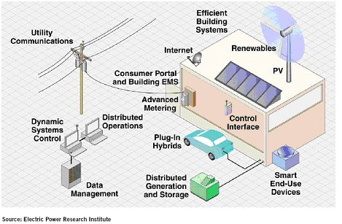
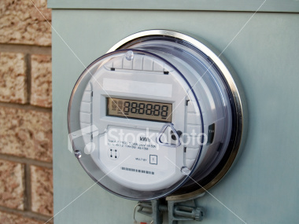
Smart Meter and Communications
Sensor Device
Able to Monitor
the Usage
of Electricity
Smart Meters should be utilized effectively

Slide 6
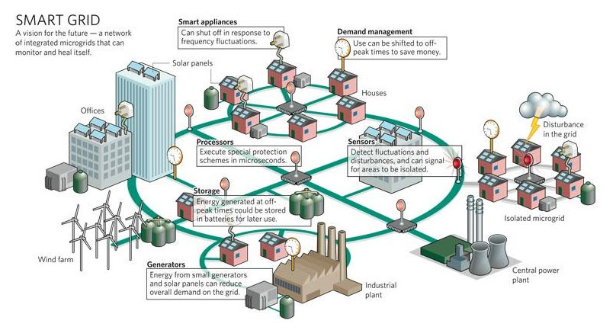
Conception Picture of Smart Grid
Management Constituting Loops in Mesh Networks
※ A method to determine the distributed control setting of looping devices for active distribution systems
http://vtsenvirogroup.wordpress.com/2009/05/19/you-think-youre-so-smart-grid/

Slide 7
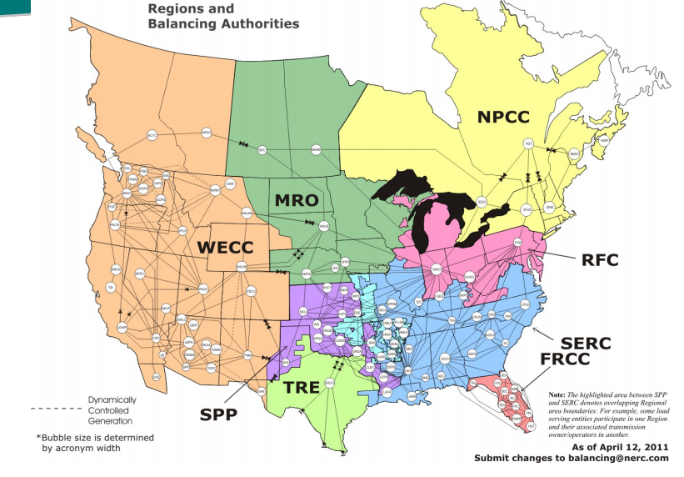
Nationwide Power Grid
http://resnick.caltech.edu/programs/smart-grid-symposium/sg-presentations/bose.pdf

Slide 8
Abstraction to Graph
Abstracted Form by Graph
There are many loops that underlie this kind of networks!
Loop segmentation method based on graph theory is proposed.

Slide 9
Tie-set Graph Theory and Distributed Control Algorithms
Since Kirchhoff’s Voltage and Current Law (KVL and KCL) in 1845
Global Optimization based on Local Optimizations
Fault Tolerance Analysis

Slide 10
Fundamental System of Tie-sets
What are the Tie-sets?
・ Loop Structure of a Power Network
b
d
Tie-set Graph Theory
・ Graph Theory focused on Loops
a
f
Applied to Distributed Control
c
e
Each node has Tie-set Information
to which the node belong
Fundamental System of Tie-sets
Cover an ENTIRE Network with LOOPS !
Advantages
・ Simplicity in Synchronization: Data is exchanged within a Tie-set
・ Reduction of Electricity Loss: Electricity is supplied within a Tie-set
Notes:
そこで本研究では、これらの問題解決に向けてタイセットに基づいた分散制御の開発に取り組んでいます。

Slide 11
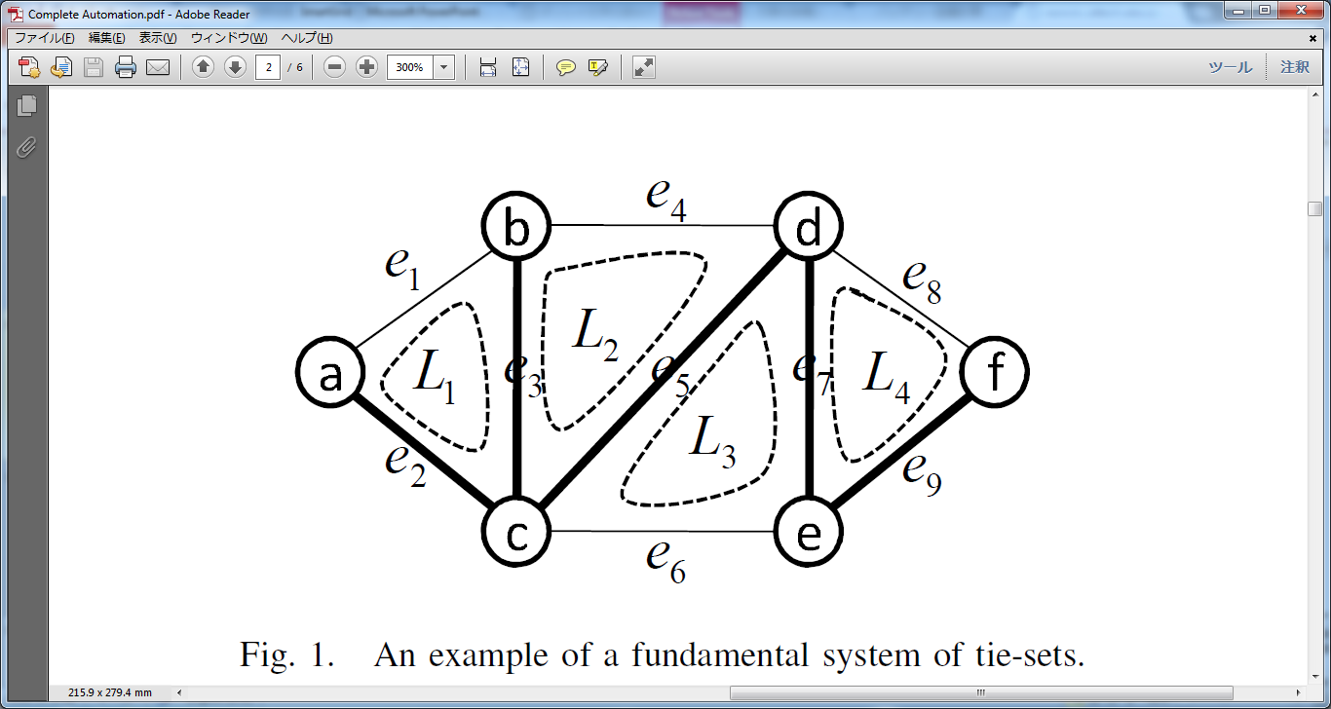
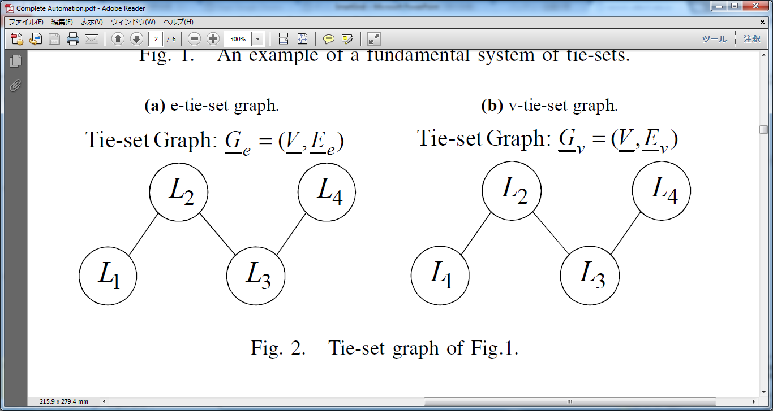
Mapping Graph to Tie-set Graph
G = (V ,E)
V ={L1,L2, ...,Lμ}
E ={e(Li, Lj)}
Connection Visible
Overlapping Resources
Communications

Slide 12
State Information of a node
① Incident Links
Links connected to a node
② Adjacent Nodes
Nodes connected to a node
③ Tie-set Information
Information of tie-sets to which a node belong
b
d
Ex: State Information of node d
a
f
Incident Links ：{e4, e5, e7, e8}
Adjacent Nodes ：{b, c, e, f}
Tie-set Information ：{L2, L3, L4}
c
e
We had also developed an algorithm
by which each node can recognize Tie-set Information
→ Easy network configuration for network managers
e1

Slide 13
Tie-Set Leader and Communications
There is one leader node in each tie-set Li
Ex. L1: c, L2: c, L3: c, L4: f
In this case, L1, L2, and L3 do not require communications. L1, L2, L3 and L4 need communications to talk each other between nodes c and f.
b
d
a
f
c
e
Tie-set Agent (TA) is always checking the status of a tie-set

Slide 14
Optimal Real-Time Distribution of Renewable Energy Resources
Constant Balanced Allocations of Renewables in Real Time
ORDER problem

Slide 15
Balanced Distribution of Renewables
General Concept
Power Grid
Distributing Powers from points that have excessive power to points that have little power by adjusting generation from fossil fuels.
Value of a Smart Meter
Value of Smart Meters：
→ Node Power: Pv(t)
Interactive Power Flow
On the basis of optimization nature of tie-set graph theory

Slide 16
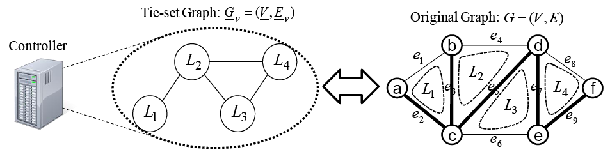
Cloud Conntrol model of a power network
The model follows the situation where controller centralizes information of smart meters in a power network.
A controller is a management system of an entire power network

Slide 17
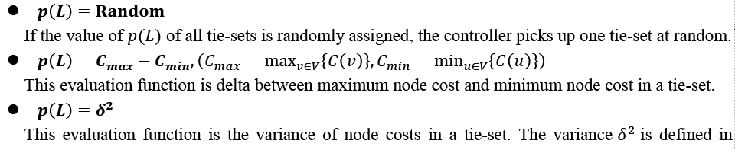
Flow chart of overall processes

Slide 18
Definitions
Pv(t): the amount of power (algebraic sum of power production, consumption, inflow, and outflow monitored by smart meters) that each node v possesses at time t
Pv(0): Initial Power
Lv(t): load of a node v at t
Rv(t): generation by renewable energy resources
Lv(t)−Rv(t) is often referred to as net demand.
The load L and renewable power R are both random processes
Dv(t): the amount of power that is produced by Centralized Generation Facility (CGF)
Pv(t) = Pv(t -1) − Lv(t) + Rv(t) + Dv(t)

Slide 19
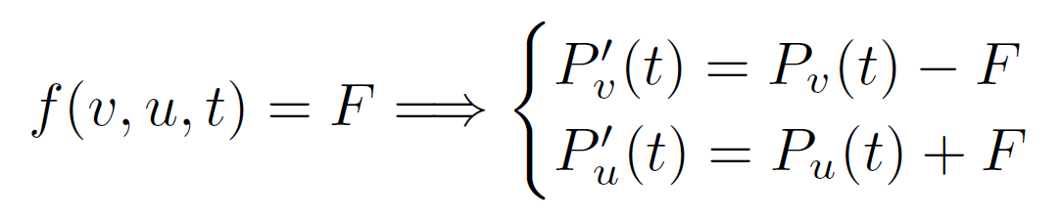
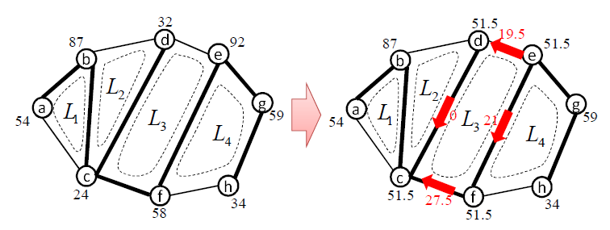
Edge Flow (Power Flow, Load Flow)
For any two vertices v, u (v ̸= u), let f(v, u, t) be a power
flow over an edge e(v, u) from vertex v to u at time t,
where if f(v, u, t) flows along the direction of an edge e(v, u) then f(v, u, t) > 0; otherwise f(v, u, t) < 0.

Slide 20
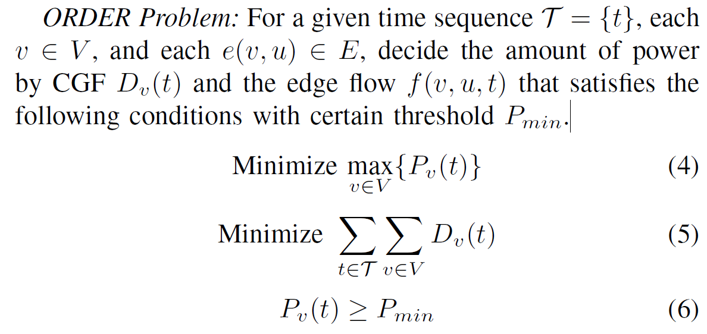
ORDER Problem

Slide 21
Autonomous Distributed Control for ORDER Problem (1)
Tie-set Agent (TA):
At each t, the a leader node of a tie-set, which is referred to as a System Operating (SO) point, receives a measurement vector y(t) that provides information about Pv(t), (v ∈ Vi) in Li.
load Lv(t), renewable power generation Pv(t), weather forecasts, pricing info, among others than Pv(t).
Tie-set Agent (TA) constantly navigates around on a tie-set and bring the data to a leader node with certain time interval (TI).

Slide 22
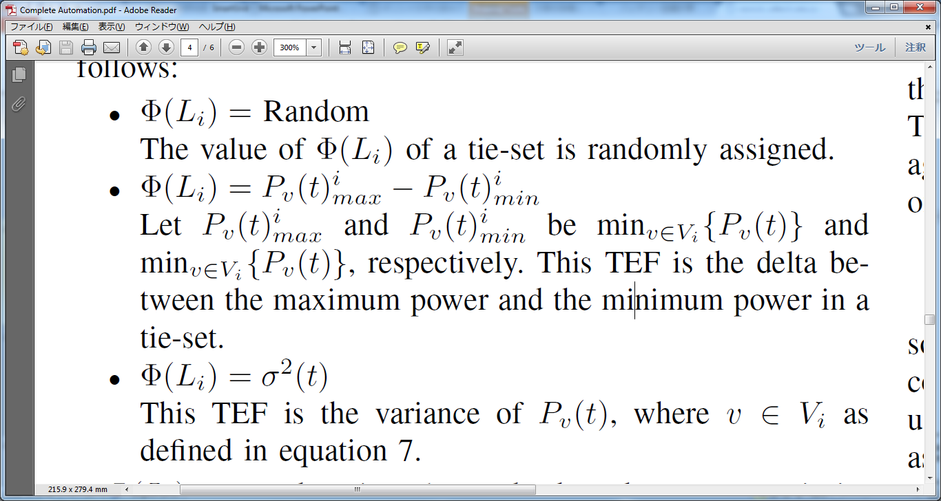
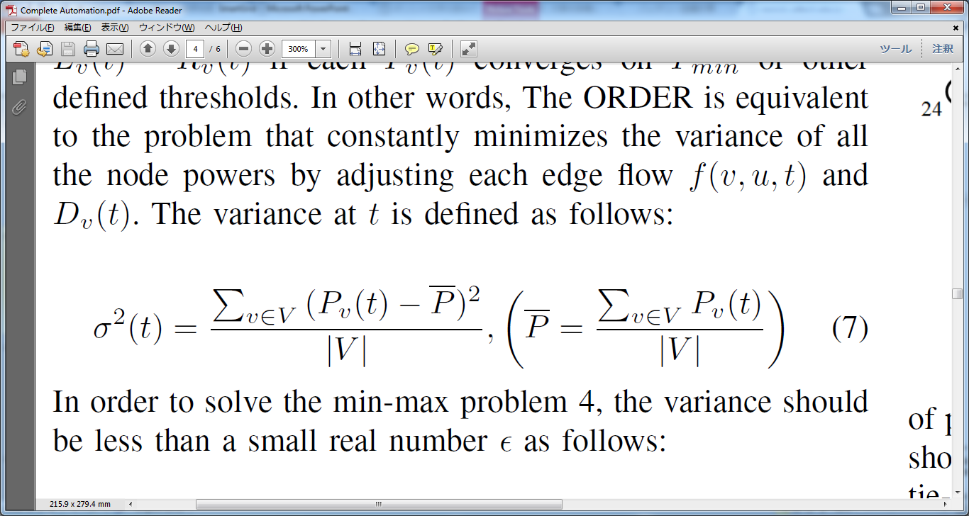
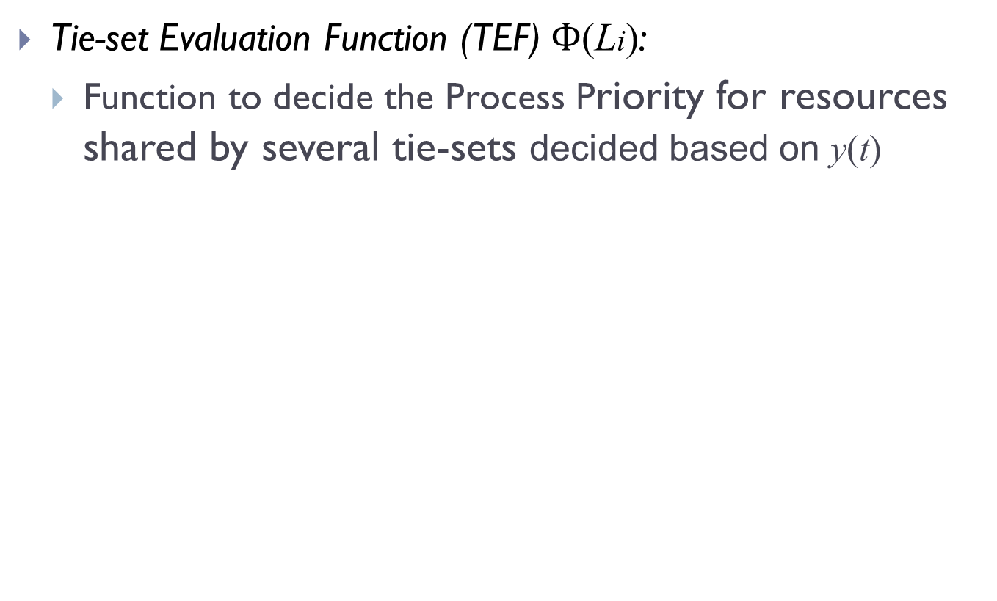
Autonomous Distributed Control for ORDER Problem (2)
Tie-set Evaluation Function (TEF) $Ф$(Li):
Function to decide the Process Priority for resources shared by several tie-sets decided based on y(t)

Slide 23
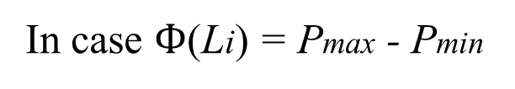
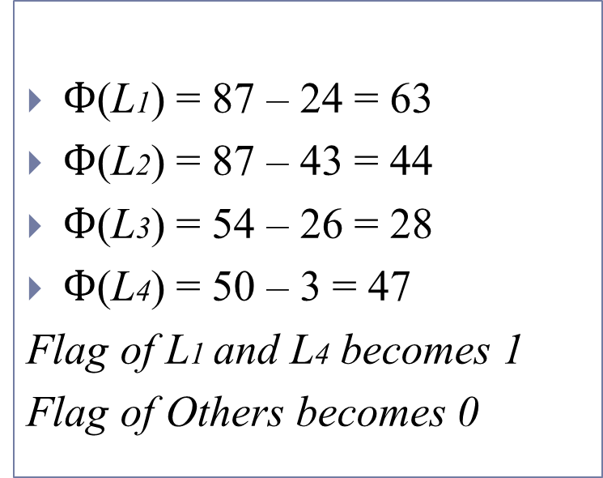
Autonomous Control with TEF
Exchanging TEF by Message Passing
Using Flag Concept
Parallel Optimizations are feasible
Example
43
$Ф$(L1) = 87 – 24 = 63
$Ф$(L2) = 87 – 43 = 44
$Ф$(L3) = 54 – 26 = 28
$Ф$(L4) = 50 – 3 = 47
Flag of L1 and L4 becomes 1
Flag of Others becomes 0
In case $Ф$(Li) = Pmax - Pmin
87
d
28
b
e
a
g
24
50
c
54
h
f
3
26
L1 and L4 conduct optimization. The procedures are constantly iterated.

Slide 24
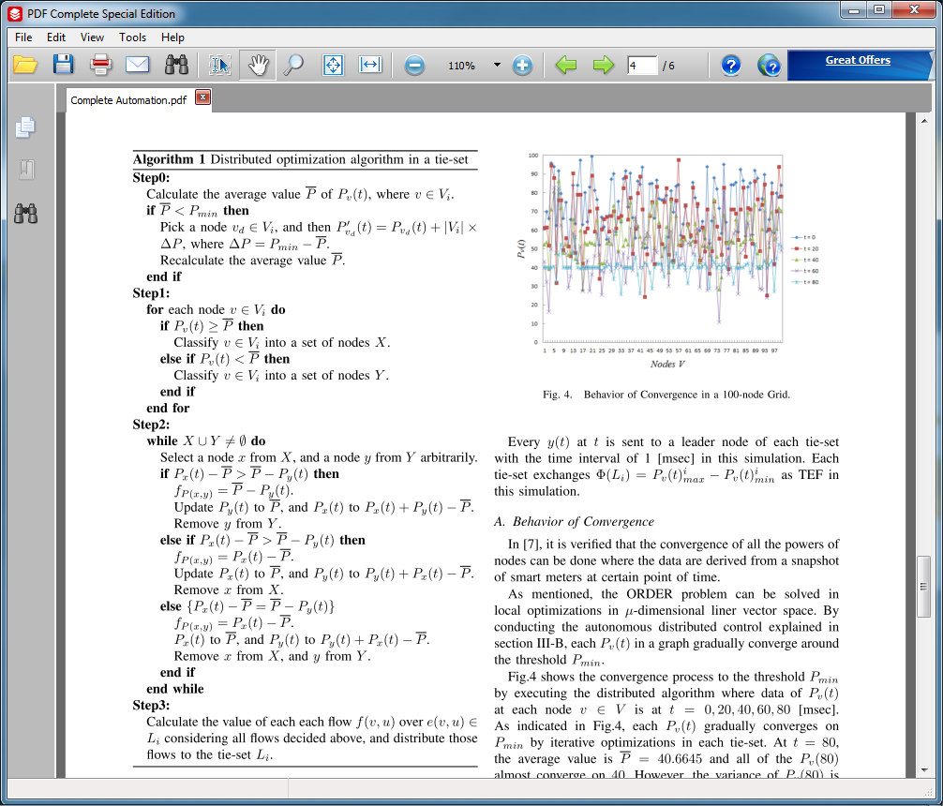
Distributed Optimization Algorithm within a Tie-set

Slide 25
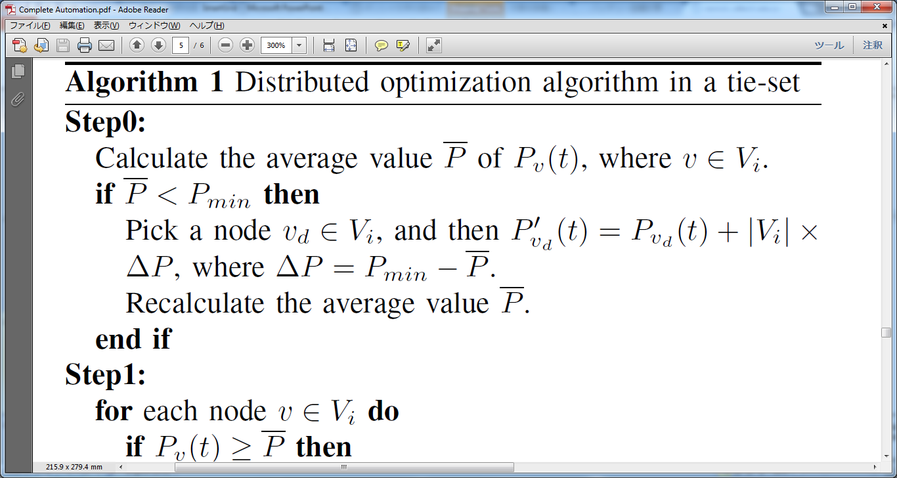
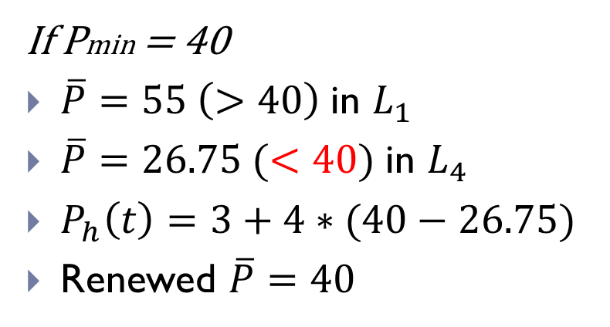
Distributed Optimization Algorithm within a Tie-set (Step0)
43
87
d
28
b
e
If Pmin = 40
$\overline{P}=55 \left(>40\right) \text{in}$ $L_{1}$
$\overline{P}=26.75 (<40) \text{in}$ $L_{4}$
$P_{h}\left(t\right)=3+4∗(40−26.75)$
Renewed $\overline{P}=40$
a
g
24
50
c
54
h
f
3
26
56

Slide 26
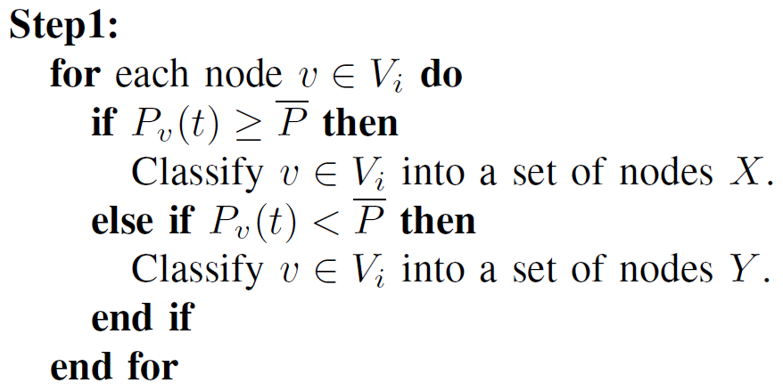
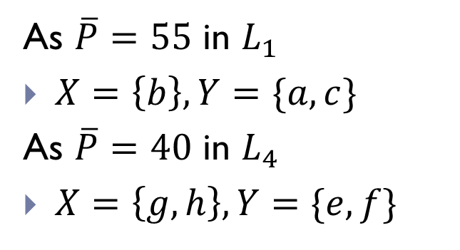
Distributed Optimization Algorithm within a Tie-set (Step1)
43
87
d
28
b
e
As $\overline{P}=55$ in $L_{1}$
$X=\left\{b\right\}, Y=\{a,c\}$
As $\overline{P}=40$ in $L_{4}$
$X=\left\{g,h\right\}, Y=\{e,f\}$
a
g
24
50
c
54
h
f
56
26

Slide 27
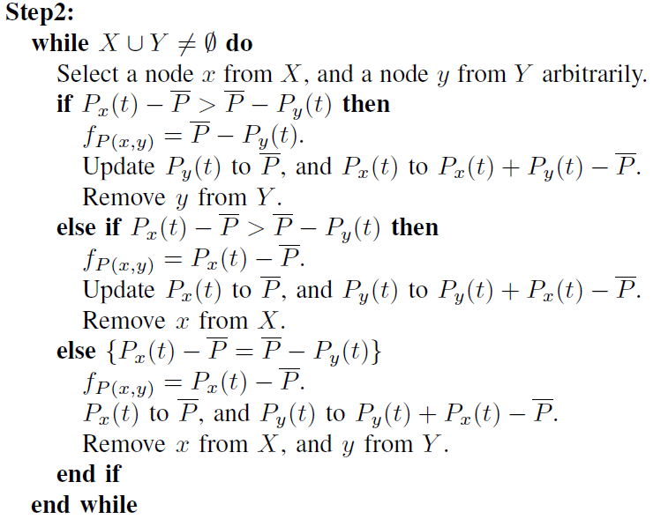
Distributed Optimization Algorithm within a Tie-set (Step2)

Slide 28
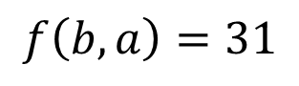
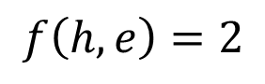
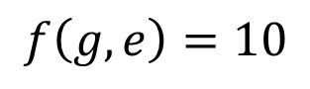
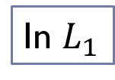
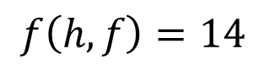
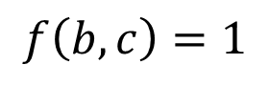
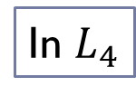
Distributed Optimization Algorithm within a Tie-set (Step2)
In $L_{1}$
X
b (87)
$$f\left(b,a\right)=31$$
43
31
1
87
d
28
Y
$$f\left(b,c\right)=1$$
e
a (24)
c (54)
b
a
g
24
50
In $L_{4}$
c
54
h
g (50)
h (56)
f
56
X
$$f\left(g,e\right)=10$$
26
10
2
14
Y
$$f\left(h,e\right)=2$$
e (28)
f (26)
$$f\left(h,f\right)=14$$

Slide 29
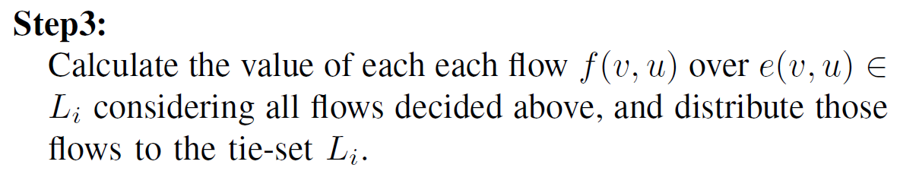
Distributed Optimization Algorithm within a Tie-set (Step3)
43
32
87
d
28
55
d
40
b
e
b
e
-31.0
-12.0
a
g
a
1.0
g
24
50
55
0
40
0
-2.0
c
c
54
h
55
h
f
56
f
14.0
40
26
40

Slide 30
Simulations and Experiments

Slide 31
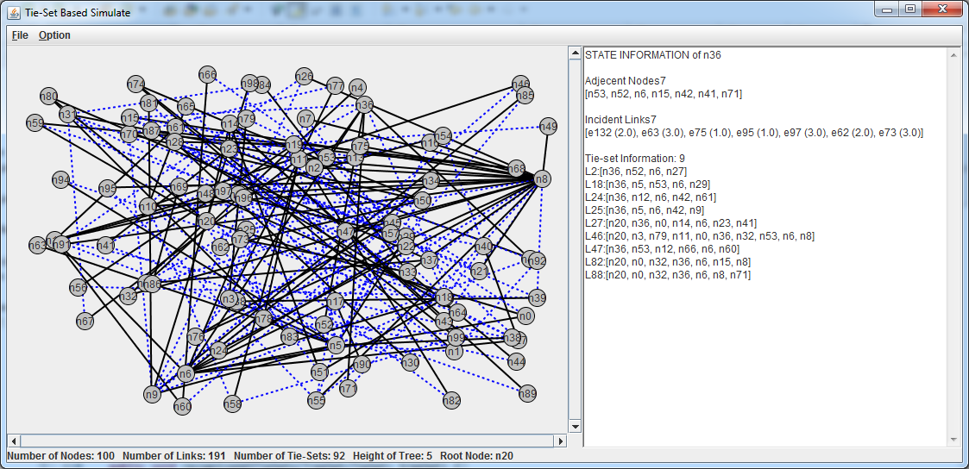
Simulation Conditions
Simulation network G = (V,E)
undirected and bi-connected
100 nodes and 190 links with random connection
Initial Power Pv(0) is assigned from 50 to 100 at random
Pmin = 40
For a given time sequence S = {0, 5, 10, ..., 100} [msec], Lv(t) and Rv(t) are given between 0 to 20 and 0 to 10 at random
Behavior of Overall
Convergence
Behavior at a Node

Slide 32
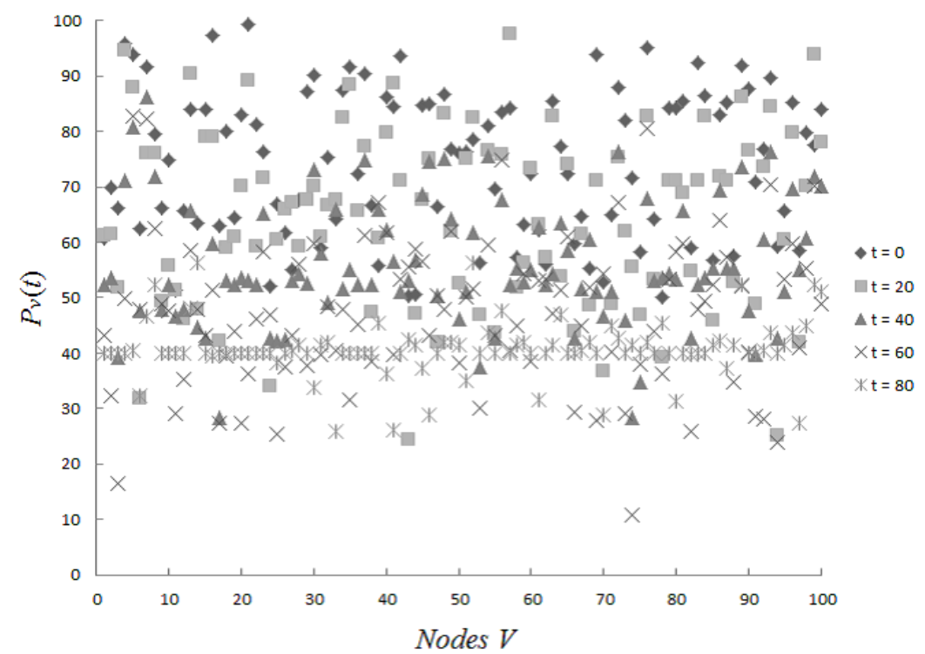
Behavior of Convergence with 100 nodes
Converge on Pmin (= 40)

Slide 33
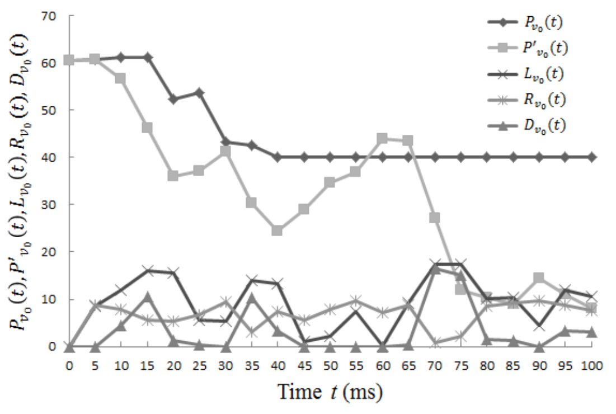
Behavior of a Node v0
Pv(t) = Pv(0) − Lv(t) + Rv(t) + Dv(t) (With Optimization)
P′v(t) = Pv(0) − Lv(t) + Rv(t) (Without Optimization and Dv(t))

Slide 34
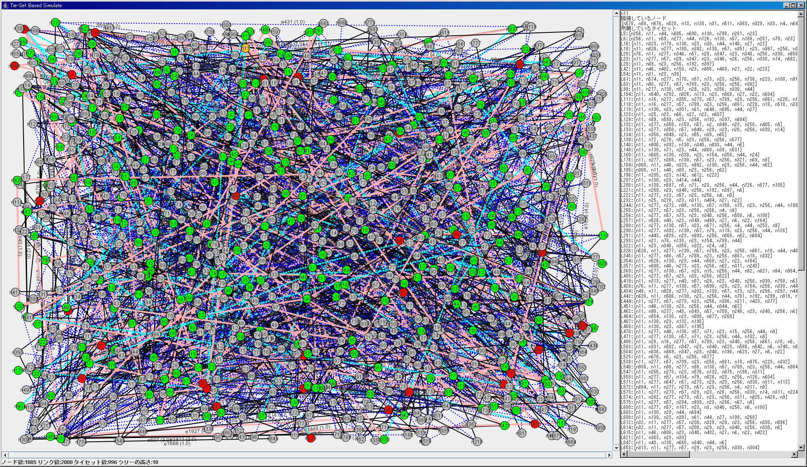
1000 node network

Slide 35
Convergence in 1000-node network

Slide 36
Conclusion
Tie-set Graph Theory and its Distributed Algorithms are introduced as a theoretical background.
Tie-set Graph Theory is the logical approach to divide a graph into a set of independent loops.
Optimal Real-Time Distribution Problem of Renewable Energy Resources (ORDER) is formulated and Autonomous Distributed Control method for ORDER is proposed.
Simulation results of one hundred-node network demonstrate the optimal distribution of renewables and thus effectiveness of the proposed method.

Slide 37
Future Works
Transmissions Loss, Conversion Loss, Error Measurement, and characteristics of Central Generation Facilities
More Intelligent Approach
Measurement of Rate of Changes at a node or tie-set to design time interval to conduct optimization
Computation of Pricing and Security
Pragmatic Simulations
Experiment on a larger-scale network
Evaluation of TEF and its behavior
Feed more constraints from the energy harvesting side

Slide 38
Thank you for your kind attention!

Slide 39
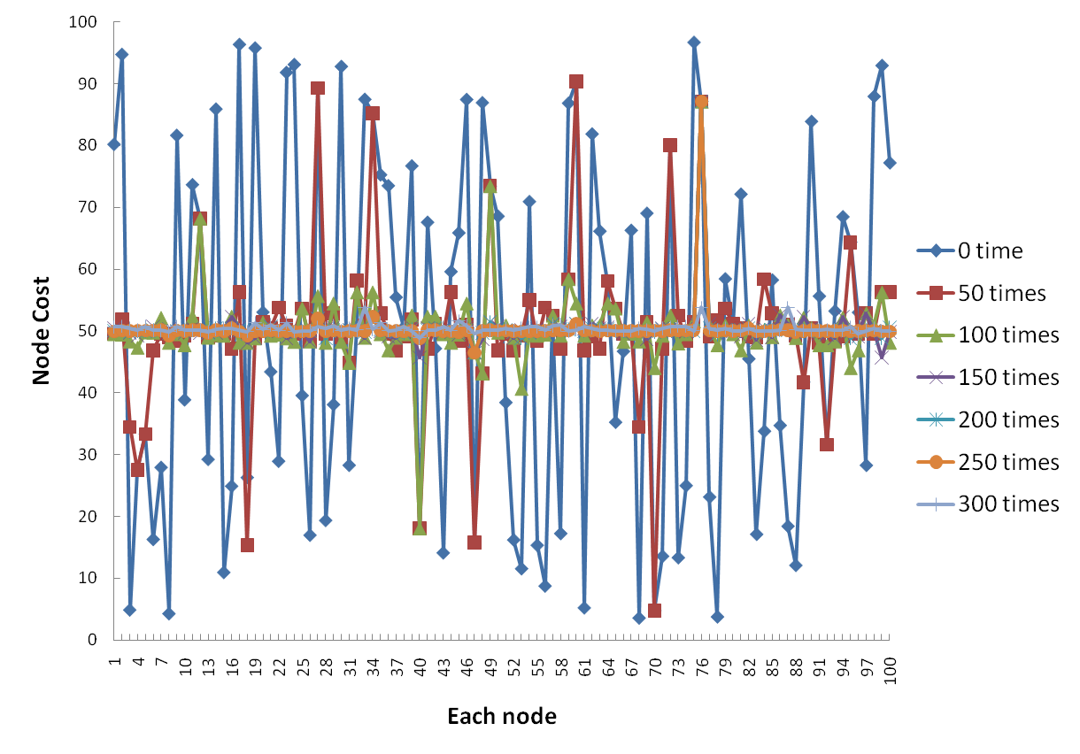
Simulation Results (100 Nodes)

Slide 40
Process of Convergence
Node Costs eventually CONVERGED on the Average Point

Slide 41
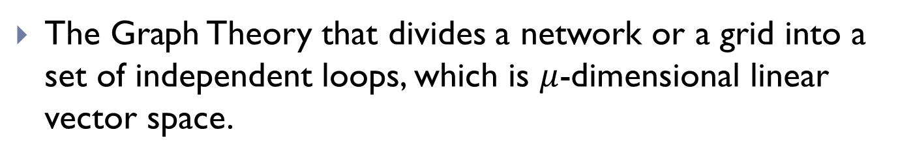
Tie-Set Graph Theory
The Graph Theory that divides a network or a grid into a set of independent loops, which is $μ$-dimensional linear vector space.
f
i
b
k
d
a
g
c
l
e
h
j

Slide 42
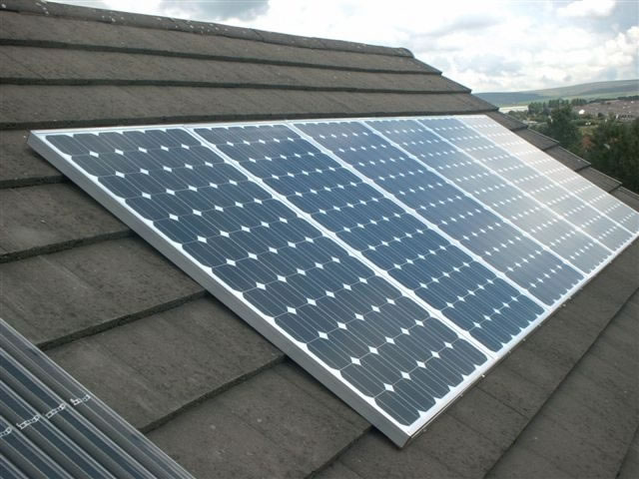

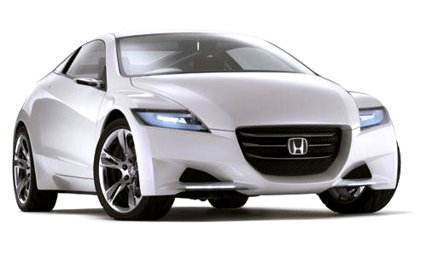
Policy of Smart Grid
Realization of interactive information distribution utilizing IT technologies
Power Generation: Each facility like factory and house
Storage: battery of electric automobile
Networking: Smart Meters which monitor power generation and consumption
To restrain generating excessive electricity

Slide 43
Present Issues on Smart Grid
Adjustment of generation in power stations
Prevent power station from generating excess electricity
Stations need to grasp the amount of generation in each facility using IT
Large scale management
Previously power stations transmit send electricity to houses unidirectionally
Controlling interactive flowing is required
Investment around 11 billion dollars

Slide 44
Present Issues on Smart Grid
Change in electricity loss rate (in the U.S.)
In 1970 approximately 5％
↓
In 2001 approximately 9.5％
Blackout or quality degradation of power supplies
Economical effect: 25 billion to 1,80 billion dollars
90 minutes to recover blackout on average
June 1st 2009
+4.5%

Slide 45
Our Research Target

Slide 46
Functions of Smart Meters
1) Presence Function:
Monitoring generation and usage of electricity
Able to digitize data
Wireless or Cable communication
Able to provide data with electric operators or outside applications
2) Load Shedding Function:
ON/OFF of equipment and systems
Electrical equipment such as lights, air conditioners, TVs, and kitchen appliances can be controlled under the direction of electric power company to adjust electric loads on a grids.

Slide 47
Objective and Tasks
Realization of distributed control for
Configuration, Failure, Performance
management based on tie-sets in a smart grid
Tasks：
Configuration：Segmentation of a smart grid by tie-sets and formulation of local information
Failure Recovery：Restoration for line failure based on tie-sets
Performance： electric load management using concept of tie-set flow theory

Slide 48
Segmentation of a network
Segmentation
using tie-set theory
n1
n3
L１
L2
L4
Tie-set distribution is different
by formulation of tree
n0
n5
L3
n2
n4
Creation of Optimal Tree is under way
n1
n3
n1
n3
L2
L4
L１
L2
L4
n0
L1
n5
n0
n5
L3
L3
n2
n4
n2
n4

Slide 49
Failure Detection based on tie-sets
Detection method of line failure using a tie-set system
Feature
Applicable to mesh networks
Simple and fast switching
n1
n3
L１
L2
L4
n0
n5
L3
n2
n4

Slide 50
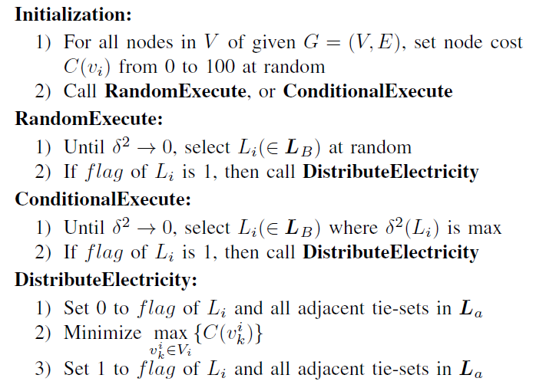
Distributed Algorithm

Slide 51
Simple Flow of the Process
Input C(vi) (i = 0, 1, …, |V|)
Select one Tie-set Li where max{C(vi)} – min{C(vi)} is the biggest
Average node costs in Li
No
Yes
Output:

Slide 52
Simulation Results

Slide 53
Tie-Set Graph Theory

Slide 54
Existing Protocols Focusing on Loops

Slide 55
Flow of the Process

Slide 56
Balanced Distribution of Renewables
Value of a Smart Meter
ORDER Problem
Optimal Real-time Distribution of renewable Energy Resources
Value of Smart Meters：
→ Node Power: Pv(t)
Interactive Power Flow
On the basis of optimization nature of tie-set graph theory

